Slide 1
Config Service - Phase 1(Current)
Components
Config Service: Exposes configuration to clients.
Config Admin Service: Handles config Sync & Labels Creation/Update.
Config UI: Developers/SRE platform interface.
Config Clients: Java,.Net and UI
Apigee proxy
Features:
Property sync
Dynamic refresh
Vault secrets retrieval
APIs
Dashboard to register apps and maintain labels
Current Client-Server Model
[Config Clients (Apps)]
|
| REST API
v
[APIGEE PROXY]
|
| REST API
v
[Spring Cloud Config Server]
|
| Git Backend
[CD Repos]
Pain Points:
No drift detection
No configs read-only view per label in UI
Limited observability,
No AI insights
Scaling challenges.
Manual Sync of Properties

Slide 2
Config Service -Phase 2 or NextGen
Set of ideas and modernization solutions to evolve your Enterprise Config Service using GenAI and MCP (Model Context Protocol) Client/Server architecture, moving beyond the traditional client-server model:
Next-Generation Enterprise Config Service Architecture
Core Architecture Evolution
Current State: Traditional client-server with Apigee proxy
Future State: AI-native, MCP-powered distributed configuration mesh
Phase2 Goals
Auto onboarding
Config drift management
CICD integration
Enable Dynamic Refresh of properties without CR
Introduce self-healing, drift detection, and predictive config management.
Improve developer and SRE productivity via automation and smart UIs.
Measuring the outcome and value, requires both quantitative and qualitative metrics.
Vault Integration to automate password push to Hashicorp Vault
DriftGuard AI
"Detect. Predict. Heal."
🔧 Product Overview:
DriftGuard AI is an intelligent, full-stack configuration drift detection, analysis, and remediation platform that ensures consistency and security across distributed environments. It leverages AI to detect anomalies, predict future drifts, and recommend actions. It is built on an MCP-based architecture, allowing seamless integration with multiple language clients and services (Java, Python, Spring, etc.).

Slide 3
🧠 Key Capabilities:
Feature | Description
🔍 Drift Detection Engine | Real-time and scheduled scanning of configs from Git, databases, live environments, or config services (e.g., Spring Cloud Config).
🧠 AI Drift Analysis | Uses LLMs and ML models to identify risky drifts, false positives, and classify changes as benign, security-related, or critical.
📜 Explainable AI Suggestions | AI explains why the drift occurred and suggests corrective actions with references to past resolutions.
📊 Drift Dashboard | A live, interactive UI with drift history, risk scores, change diffs, and auto-remediation status.
⚙️ MCP Integration | Uses MCP Server to manage client-server communication for config pull/push, drift events, and context metadata exchange.
🔁 Auto-remediation Pipelines | Smart GitOps-based or API-based fix deployment with approval workflows.
🛡️ Security & Policy Engine | Alert or auto-block config changes violating org policy or compliance (PCI, HIPAA).
📦 Plugin Framework | Integrate with Terraform, Kubernetes, Helm, Ansible, AWS/GCP, etc.

Slide 4
Security & Compliance Enhancements
AI-Powered Secret Detection: Automatically identify and protect sensitive data
Compliance Automation: AI ensures all configurations meet regulatory requirements
Zero-Trust Configuration: Every config change requires AI-verified authorization
Audit Trail Intelligence: Natural language audit queries and reports

Slide 5
Architecture Redesign: MCP-Client-Server + GenAI
Proposed: 📦 MCP-Based Architecture Foundation:
MCP Server (Control Plane): Manages centralized config metadata, AI services, audit logs, and policy enforcement.
MCP Clients (Data Plane): Lightweight agents embedded into apps/containers, auto-pull configs and execute local validation & drift checks.
MCP AI Orchestrator: GenAI module to assist with onboarding, analysis, drift resolution, etc.
Pros:
Decoupled and extensible via SDKs Supports versioning, rollback, and GitOps Scalable with consistent interface
MCP Clients → MCP Gateway → MCP Config Server → Config Store (Git/DB)
MCP Client/Server Implementation
MCP Server: Maintains configuration context across all environments
MCP Client: Provides AI-powered configuration assistance to developers
Context Sharing: Seamless knowledge transfer between different AI agents
Key Differentiator: Unlike current polling-based config sync, MCP clients use context-aware pull + AI push (hybrid) and intent-based diff resolution.

Slide 6
+---------------------------+
| MCP Client SDKs | <- Apps (Java, Python, Node.js)
+---------------------------+
|
+---------------------------+
| MCP Gateway | <- Handles auth, routing, metrics
+---------------------------+
|
+---------------------------+
| MCP Config Server |
|---------------------------|
| Config Fetch & Apply |
| Versioning & Rollback |
| GitOps Sync |
+---------------------------+
|
+---------------------------+
| Config Store | <- Git, S3, DB
+---------------------------+

Slide 7
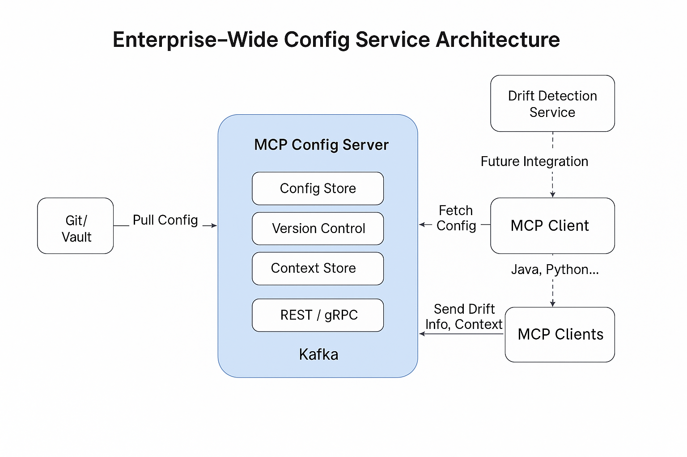

Slide 8
MCP + AI + Drift Management Architecture
+--------------------------+
| App MCP Clients |
| (SDKs, Agents, Sidecars) |
+-----------+--------------+
|
v
+--------+---------+
| MCP Gateway |
+--------+---------+
|
+-------------------+-------------------+
| |
v v
+------------------+ +----------------------+
| MCP Config Server| | Drift Detection Engine|
|------------------| |----------------------|
| GitOps Sync | | Compare Desired vs |
| Versioning | | Actual Configs |
| Rollback | | Alerting & Audit |
+------------------+ +----------------------+
| |
v v
+--------------------+ +---------------------------+
| Config Store (Git)| | Observability & Logs |
+--------------------+ | (Elastic, Prometheus, etc)|
+---------------------------+
+-----------------------------+
| AI Agent Platform |
|-----------------------------|
| Drift Root Cause Analysis |
| Auto-remediation Suggestions |
| Config Optimization Hints |
+-----------------------------+
Drift Engine compares desired state (Git/S3) vs runtime state (from agent reports or kube API).
AI Agent uses embeddings, prompt engineering, and LLMs to recommend:
What changed?
Why it might have changed?
How to fix or optimize it?
✨ Optional Enhancements
Kafka or Flink for stream-based drift alert processing
Vault integration for secrets
RBAC/SSO/OAuth via Gateway
Audit trails for config updates

Slide 9
MCP + AI + Drift Management
AI-Driven Config Drift Management
Solution: Continuous Configuration Intelligence
Drift Detection AI: ML models trained on configuration baselines to identify anomalies
Root Cause Analysis: GenAI explains why drift occurred and suggests remediation
Predictive Drift Prevention: Forecasts potential configuration conflicts before deployment
Self-Healing Configs: Automated rollback and correction mechanisms
MCP Clients → MCP Gateway → MCP Config Server + Drift Detection Engine
Drift Detection Engine → Observability (Elastic, Prometheus)
AI Agent Platform → Recommendations, RCA, Optimization
Bullet Points:
Detects and visualizes config drift
AI-driven root cause and fix suggestions
Alerts and audit trails

Slide 10
GenAI-Enabled Config Intelligence
AI-Powered Drift Detection & Auto-Remediation
Train GenAI models on config history, incidents, and infra changes.
Auto-identify config drift across environments.
Suggest & apply fixes with approvals.
b. AI Copilot for Config Writing & Review
Developer Copilot in UI/CLI that:
Suggests optimal config values.
Highlights anti-patterns or deprecated flags.
Auto-generates config templates based on service type (e.g., Kafka, Postgres, Spring Boot).
c. Natural Language Interface (NLI)
Ask: “Show me all configs using deprecated feature flags.”
Ask: “What changed in config that may cause memory issues?”

Slide 11
3. Smart Context-Aware Config Serving via MCP
Each client sends context: environment, infra, version, load, region, etc.
MCP Server delivers tailored config slices with overrides, fallbacks, and policies.
Real-time Diff Viewer and Change Impact Analysis
Visual UI to:
Compare environment configs.
View historical change impact.
See “who changed what” and “what it caused.”
GenAI highlights potential blast radius of config changes.

Slide 12
GenAI-Driven Automation & Intelligence
GenAI-Powered Auto Onboarding
Solution: Intelligent Configuration Discovery & Bootstrapping
AI Config Analyzer: Scans existing applications to auto-detect configuration patterns
Smart Template Generation: Creates baseline configs based on application type, tech stack, and deployment patterns
Natural Language Onboarding: Developers describe their service requirements in plain English
MCP Integration: Uses Model Context Protocol to maintain context across onboarding sessions
Auto Onboarding with GenAI Copilot:
Use LLMs to read application manifests (k8s, helm charts, Dockerfiles).
Auto-suggest required configs.
Recommend best practices based on internal patterns and external security benchmarks (e.g., OWASP, NIST).
Drift Detection & Fix Assistant:
Daily/trigger-based MCP client snapshot & hash comparison.
AI explains the diff in plain language and recommends automated fixes.
UI view with “Approve & Fix” workflows.
Intelligent Config Validation:
GenAI to evaluate config changes against usage patterns.
Predictive alerts (e.g., “This change may cause downtime for XYZ service”).

Slide 13
CI/CD & GitOps Integration
Pipeline Enhancements:
Harness CD Integration
Automate Git PR validations via MCP policy engine.
Plugins for Jenkins, GitHub Actions, or GitLab CI that:
Validate config against policies via MCP Server.
Standard Git CD Repo Branch Strategy:
main – production configs
release/* – versioned releases
feature/* – temporary or experimental

Slide 14
Secrets & Backup Improvements
Vault Secrets Integration (Improved):
Unified secrets access through MCP client abstraction.
Vault Integration to automate password push to Hashicorp Vault
Config Backup & Restore:
Store snapshots as Kubernetes ConfigMaps and dumps.
Version-controlled in Git (tagged by environment/app).
Daily automated backup routines via MCP Server.

Slide 15
Developer/SRE Experience (UI & APIs)
Next-Gen Unified UI Portal:
One dashboard for developers, SREs, and platform engineers.
Modules:
AI Onboarding Assistant
Drift Visualizer
GitOps Change Viewer
Secrets Keys Viewer
Environment Comparison
APIs:
REST/gRPC APIs exposed via MCP for config pull/push, diff checks, drift alerts, validation, and secrets sync.

Slide 16
Observability & Metrics
Dashboards for:
Drift Trends
Rollback Events
Config Audit Trail
Auto-Onboarding Success Rates
KPI Suggestions:
Mean Time to Detect (MTTD) Drift
% of Apps Auto-Onboarded
Config Rollback Frequency
Pipeline Validation Success Rate
Secrets Resolution Failures
Success Metrics
Onboarding Time: Reduce from days to minutes
Configuration Drift: 95% reduction in production incidents
Developer Productivity: 60% faster configuration management
Compliance: 100% automated compliance checking
Recovery Time: Sub-minute configuration restoration

Slide 17
Benefit | Description
⏱️ Time Saved | AI Copilot & Smart UI accelerate development
⚠️ Fewer Incidents | Drift detection & rollback mechanisms
🔄 Continuous Optimization | GenAI learns and recommends better config over time
📉 Cost Optimization | Detects over-provisioned resource configs
👥 Better Collaboration | Role-specific tools and explainability

Slide 18
Metric | How to Measure | Value
🕒 Time to update/apply config | Avg. time to deploy config changes before vs. after modernization | Faster delivery, less downtime
🔁 Manual config changes | # of manual edits vs. AI-assisted edits | Reduction = increased automation
📉 Mean Time to Detect (MTTD) & Resolve (MTTR) | Incident logs + telemetry | Reduced incident response time
Metric | How to Measure | Value
⚠️ Config Drift Incidents | Count of drift incidents detected and remediated | Drift under control = better stability
🔄 Rollback Frequency | # of rollbacks due to faulty configs | Reduction = better quality control
🧠 Anomaly Detection Accuracy | # of AI-generated pre-warnings that matched actual impact | Indicates AI effectiveness
Metric | How to Measure | Value
🧰 Config Coverage | % of services onboarded to MCP-based config | Tracks adoption across org
🔐 Secrets Rotation Compliance | % configs with compliant rotation cycles | Higher % = better security posture
⏱️ Change Approval Lead Time | Time from config submission to approval | Faster approvals = efficient governance
Metric | How to Measure | Value
💸 Cost Savings from Outage Reduction | Downtime × $ impact avoided post-modernization | Tangible ROI
🏗️ Environment Consistency Score | Config parity across envs (dev/stage/prod) | Less drift = fewer bugs
🚀 Release Velocity | Releases per week/month before vs. after | Faster CI/CD cycles
✅ 1. Developer & SRE Productivity
✅ 2. System Reliability & Risk Reduction
✅ 3. Operational Efficiency
✅ 4. AI Impact & Usage
✅ 5. Business Impact
Metric | How to Measure | Value
🧑‍💻 AI Copilot Adoption Rate | % of config changes suggested by Copilot | Higher usage = trust in AI tools
📊 Model Feedback Loop Accuracy | % of AI suggestions accepted without rework | Indicates model maturity
📚 Natural Language Queries Executed | Count of NLI usage by engineers | Measures real-world AI usage value

Slide 19
How to Track These Metrics
Use telemetry from MCP clients
Integrate with tools like Datadog, Prometheus, Grafana
Leverage audit logs, incident reports, and deployment history
Add AI usage analytics dashboards
Set up monthly/quarterly review reports

Slide 20
Rollout Plan / Milestones
Phase 1 – MCP Core & Clients: Drift Detection + GitOps Connector
Phase 2 – GenAI Copilot & Auto Onboarding
Phase 3 – UI Portal & Validation Pipelines
Phase 4 – Enterprise Adoption, Training, and Metrics Dashboards
Implementation Roadmap
Phase 1: Foundation (3-6 months)
Deploy MCP infrastructure
Implement basic AI validation
Migrate to container-native storage
Phase 2: Intelligence (6-9 months)
Add drift detection AI
Implement auto-onboarding
Enhanced CI/CD integration
Phase 3: Automation (9-12 months)
Full self-healing capabilities
Advanced predictive analytics
Complete GenAI integration

